Slide 1
Joint distributions
C. B. Gupta

Slide 2
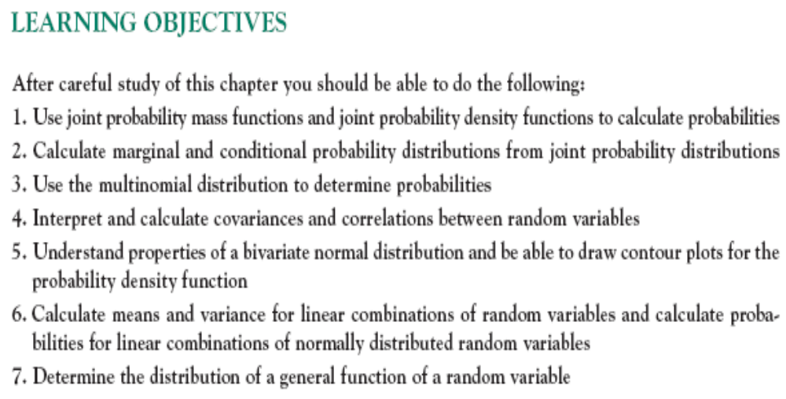

Slide 3
Discrete Joint Densities
Let X and Y be discrete random variables. The ordered pair (X,Y) is called a two-dimensional discrete random variable. A function f_{XY} such that
f_{XY}(x,y) = P[X = x and Y = y]
is called the joint density for (X,Y).

Slide 4
As in the one-dimensional case, f_{XY} is non-negative since it represents a probability. Furthermore, if the density is summed over all possible values of X and Y, it must sum to 1. That is, the necessary and sufficient conditions for a function to be a joint density for a two-dimensional discrete random variable are as follows:

Slide 5
Necessary and Sufficient Conditions for a Function to be a Discrete Joint Density:
(1) f_{XY}(x,y) ≥ o for all (x,y)
(2) ∑ ∑ f_{XY}(x,y)=1.
^{all x all y}

Slide 6
Marginal Distributions : Discrete
Discrete marginal densities : Let (X,Y) be a two-dimensional discrete random variable with joint density f_{XY} . The marginal density for X, denoted by f_{X} is given by f_{X}(x) = ∑ f_{XY}(x,y)
^{all y}

Slide 7
The marginal density for Y ,denoted by f_{Y} is given by
f_{Y}(y) = ∑ f_{XY}(x,y)
^{all x}

Slide 8
JOINT AND MARGINAL DISTRIBUTIONS : CONTINUOUS
Continuous Joint Density: Let X and Y be continuous random variables. The ordered pair (X,Y) is called a two-dimensional continuous random variable. A function f_{XY} such that :

Slide 9
f_{XY}(x,y) ≥ 0 ; -∞ < x < ∞
-∞ < y < ∞
2. ∫∞ ∫∞ f_{XY}(x,y) dy dx = 1
^{-∞ -∞}
3. P [a≤ X≤ b and c≤ Y≤ d ] =
∫^{b} ∫^{d} f_{XY}(x,y) dy dx
^{a c}
for a,b,c,d real, it is called joint density for (X,Y).

Slide 10
Continuous Marginal Densities: Let (X,Y) be a two-dimensional continuous random variable with joint density f_{XY} . The marginal
density for X, denoted by f_{X} is given by:
f_{X}(x) = ∫∞ f_{XY}(x,y) dy
^{-∞}

Slide 11
The marginal density for Y, denoted by f_{Y} is given by:
f_{Y}(y) = ∫∞ f_{XY}(x,y) dx
^{-∞}

Slide 12
Independence
Let A₁ denote the event that X=x, and let A₂ denote the event that Y=y . If X and Y are independent in the intuitive sense , then A₁ and A₂ are independent events. By definition,
P[A₁ ∩ A₂] = P[A₁]P[A₂]
Substituting, we get
P[X=x and Y=y] =P[X=x] P[Y=y] or
f_{xy}(x,y)=f_{x} (x) f_{y}(y)

Slide 13
Independent Random Variables:
Let X and Y be random variables with joint density f_{XY} and marginal densities f_{X} and f_{y} , respectively .
X and Y are independent if and only if
f_{XY}(x,y)= f_{X}(x) f_{y}(y)
for all x and y.

Slide 14
Question
Use table 2 to find each of these probabilities:
The probability that exactly two defective welds and one improperly tightened bolt will be produced by the robots.
The probability that at least one defective weld and at least one improperly tightened bolt will be produced.

Slide 15
(c) The probability that at most one defective weld will be produced.
(d) The probability that at least two improperly tightened bolts will be produced.

Slide 16
Ex.1
In an automobile plant two tasks are performed by robots. The first entails welding two joints, the second, tightening three bolts. Let X denote the number of defective welds and Y the number of improperly tightened bots produced per car. Since X and Y are each discrete, (X,Y) is a two dimensional discrete random variable. Past data indicate that the joint density for (X,Y) is shown in Table 5.1.

Slide 17
Table 1
x/y | 0 | 1 | 2 | 3
0 | .840 | .030 | .020 | .010
1 | .060 | .010 | .008 | .002
2 | .010 | .005 | .004 | .001

Slide 18
Table 2
x/y | 0 | 1 | 2 | 3 | f_{x}(x)
0 | .840 | .030 | .020 | .010 | .900
1 | .060 | .010 | .008 | .002 | .080
2 | .010 | .005 | .004 | .001 | .020
f_{y}(y) | .910 | .045 | .032 | .013 | 1.000

Slide 19
Solution:
X= No. of defective bolts.
Y= no. of improperly tightened bolts.
(a) P(X=2, Y=1) = .005
(b) P(X≥1, Y≥1) = .010+.008+.002+.005+.004+.001=.030
(c) P(X≤1) = P(X=0 or X=1) = .900+.080=.980

Slide 20
Contd…
(d) P(Y≥2) = P(Y=2 or Y=3) = .032+.013=.045

Slide 21
Q 3
The joint density for (X,Y) is given by
f_{XY}(x,y) = 1 / n² ;
x = 1,2,3,…,n ; y = 1,2,3,…,n ;
Verify that f_{XY}(x,y) satisfies the conditions necessary to be a density.
Find the marginal densities for X and Y.
Are X and Y independent ?

Slide 22
Q 4
Let X denote the temperature (°C) and let Y denote the time in minutes that it takes for the diesel engine on an automobile to get ready to start. Assume that the joint density for (X,Y) is given by
f_{XY}(x,y) = c(4x + 2y + 1);
0≤ x≤ 40 ; 0 ≤ y≤ 2 ;

Slide 23
(a) Find the value of c that makes this a density.
(b) Find the probability that on a randomly selected day the air temperature will exceed 20°C and it will take at least 1 minute for the car to be ready to start.
(c) Find the marginal densities for X and Y.

Slide 24
(d) Find the probability that on a randomly selected day it will take at least 1 minute for the car to be ready to start.
(e) Find the probability that on a randomly selected day the air temperature will exceed 20°C.
(f) Are X and Y independent? Explain on a mathematical basis.

Slide 25
Q 5
(n-dimensional discrete random variables.) Random variables of dimension n>2 can be defined and studied by extending the definitions presented in the 2-dimensional case in a logical way. For example, an n-tuple (X₁,X₂, X₃,…,X_{n}) in which each random variable X₁,X₂, X₃, …,X_{n} is a discrete random variable. The density for such a random variable is given by:

Slide 26
f(x₁,x₂,x₃,…,x_{n}) = P[X₁=x₁,X₂ = x₂, X₃ = x₃,…,X_{n} = x_{n}]
This problem entails the use of three-dimensional random variable.
Items coming off an assembly line are classified as being either nondefective, defective but salvageable, or defective and nonsalvageable. The probabilities of observing items in each of these categories are .9, .08 and .02 respectively. The probabilities do not

Slide 27
change from trial to trial. 20 items are randomly selected and classified. Let X₁ denote the number of nondefective items obtained, X₂ denote the number of defective but salvageable items obtained and X₃ denote the number of defective and nonsalvageable items obtained .
(a) Find P[X₁=15,X₂ =3,X₃=2]
(b) Find the general formula for the density for (X₁,X₂, X₃).

